Slide 1
Vineyard Church of Davenport
We are a dynamic, multi-ethnic,
multi-generational community on a mission to serve and save our cities by following Jesus Christ.

Slide 2


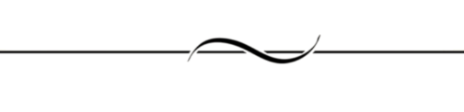
Follow us on social media
“Vineyard Church of Davenport”
@davenportvineyard

Slide 3
Hate e-mail? Rather connect by text?
If you want to get Vineyard info notices by text:
1. TEXT your First & Last name to (563) 362-9502.
2. TEXT “General” to (563) 362-9502.
3. WRITE your cell phone number on the CONNECT! Card in your bulletin & drop it in the offering basket.
4. You’re now text connected to the Vineyard!
New Number? Do this again with your new number to stay connected!

Slide 4

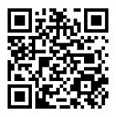
Download our app!
Listen to past messages
Submit urgent prayer requests
Live Streaming
Events Calendar
Give to the mission of VCD
Read the Bible
Link to Facebook & Twitter
Search “Vineyard Church of Davenport”

Slide 5

Soaking Prayer
Got a big issue in your life?
Would you like to have a team pray for you?
Try Soaking Prayer!
Sign up @ Info Center
Go to prayer room by Vineyard Kids entrance

Slide 6
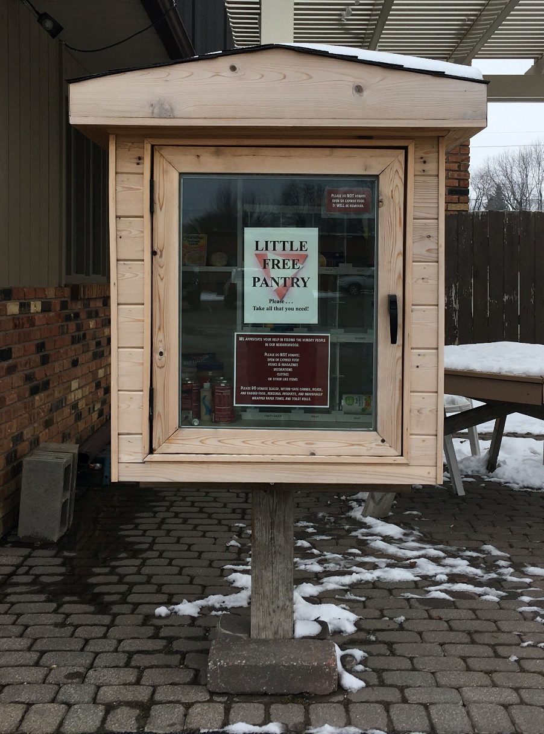
Donations for our Little Free Pantry are ALWAYS welcome!
Suggested items include
(but are not limited to):
Canned vegetables (corn, green beans, peas, pork & beans, etc.); Canned fruit (peaches, pears, pineapple, applesauce, etc.); Canned tuna and chicken; Canned condensed soup & crackers in sleeves; Macaroni & cheese dinners; Hamburger & Tuna Helper (or similar); Spaghetti & Spaghetti sauce; Cereal; Paper towels (individual rolls)
Please, no expired or open items!
Place your donations by the black bookshelf in the entry foyer.

Slide 7


Slide 8


Slide 9
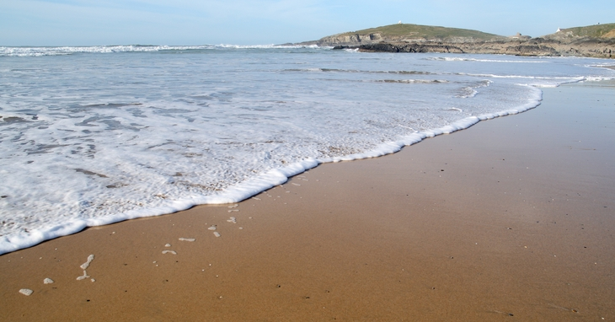
Encouraging Words
Need some encouragement in life?
Would you like to know how God feels about you?
Try an Encouraging Words session!
Sign up @ Info Center
Go to prayer room by Vineyard Kids entrance

Slide 10




4 WAYS TO GIVE TO GOD
THROUGH THE VINEYARD CHURCH OF DAVENPORT
Text “VCDavenport” to 77977
Give Online www.davenportvineyard.org
Giving Envelope Cash, Check or Credit Card
VCD App: Download from your app store

Slide 11
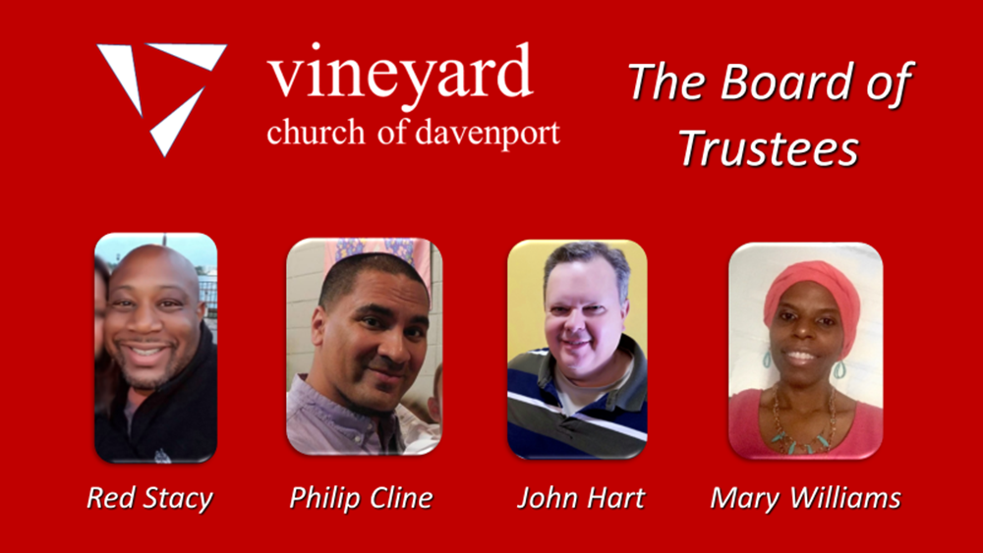

Slide 12
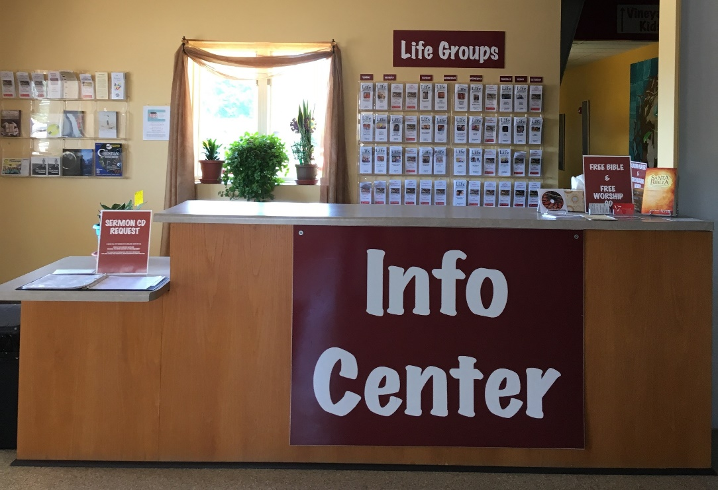
Have questions?
Need to sign-up for an event or class?
Need healing prayer?
Want more info on
Life Groups?
All this and more at the
INFO CENTER

Slide 13
La Iglesia La Vińa de Davenport:
Una dinámica, multi-étnica,
multi-generacional, de la comunidad en una misión para servir y salvar nuestras ciudades siguiendo a Jesucristo.

Slide 14
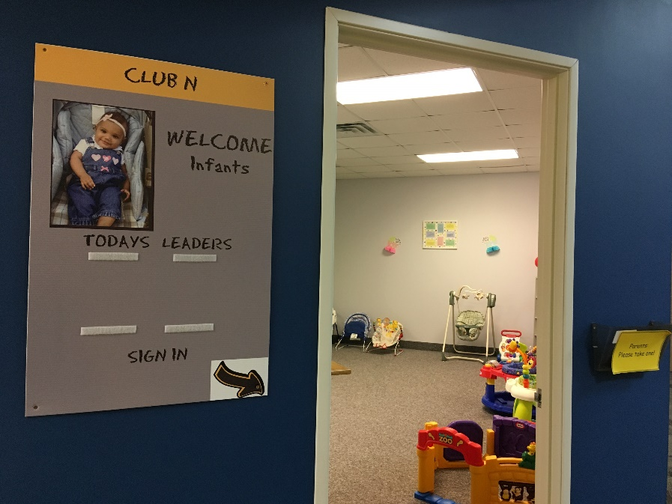
CLUB N
Located in
VK Wing
For babies that need comforting

Slide 15
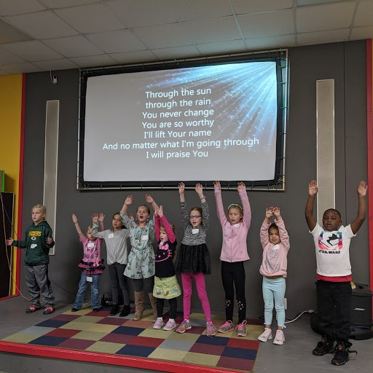

VK VINEYARD KIDS
Nursery - 6th grade

Slide 16

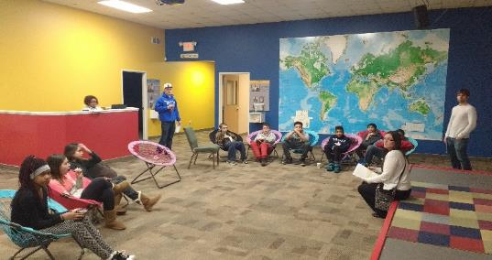
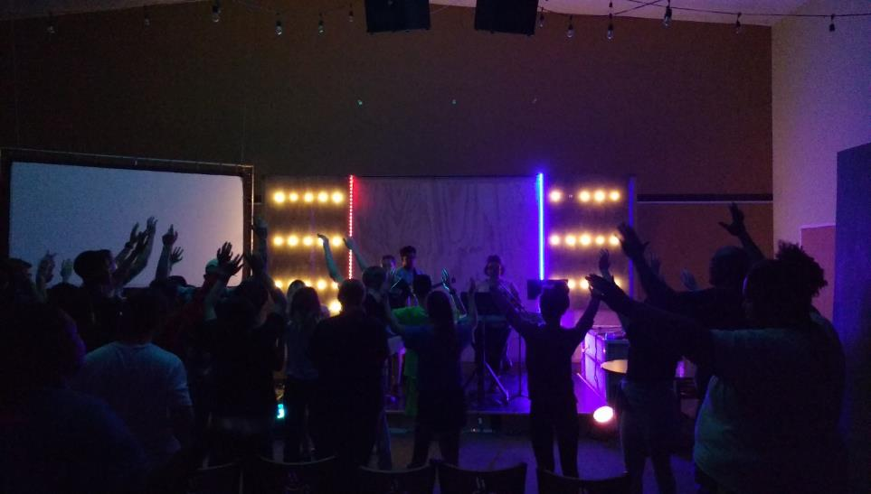
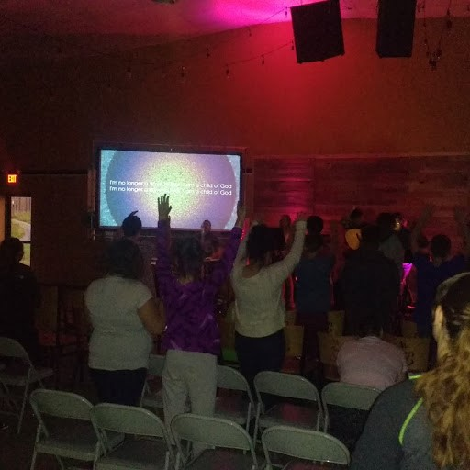
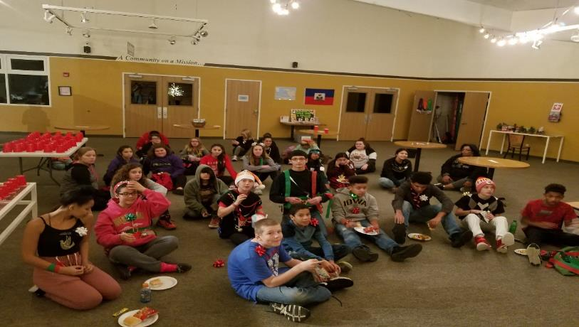
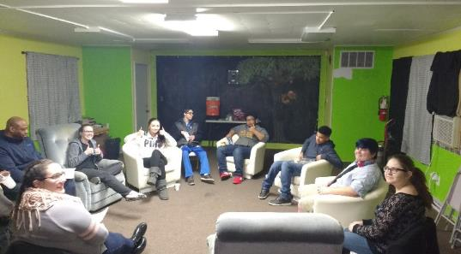
Vineyard Church of Davenport
VINEYARD YOUTH
7th -12th grade
2nd - 5th WEDNESDAYS
6-8 pm
2nd-5th Wednesdays 6-8pm

Slide 17
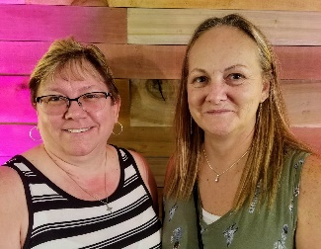
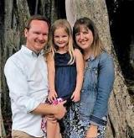
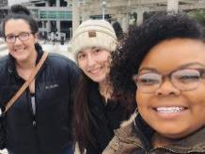
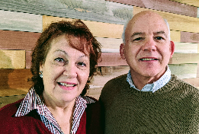
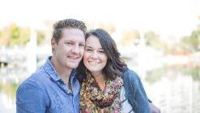
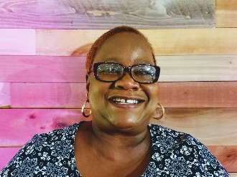
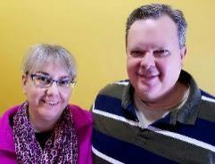
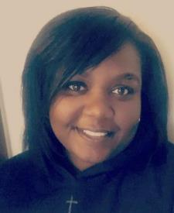
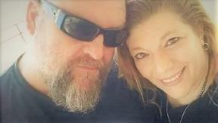
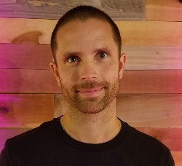
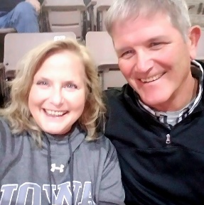
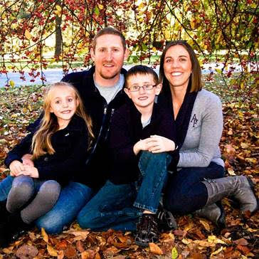
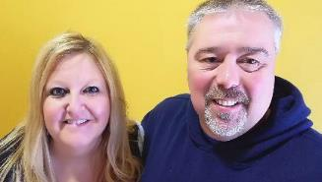
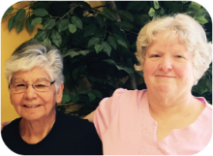
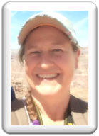
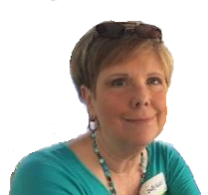
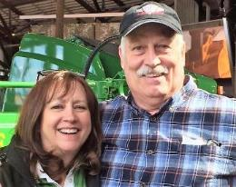
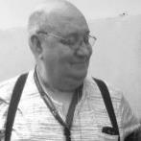
MON TUES WED THURS FRI/SAT/SUN
Life Group
Leaders

Slide 18
UPCOMING EVENTS
Mon.- Fri. 9-9:30 am
Prayer with Staff at the Vineyard Office
King’s Harvest (824 W. 3rd St.)
Free meals & grocery giveaways:
Lunch every Wed. & Fri. (11:30)
Breakfast every Sat. (8:30 am)
Free bag of groceries the 2nd & 4th Saturday each month.
Interested in helping?
Write on Connect! Card today!

Slide 19
What’s this church all about?
Vineyard CONNECT is your chance to find out how you can get connected at the Vineyard and learn more about topics like the Vineyard’s Core Values, Mission and Strategy. After taking this class, you can also decide if you would like to be a formal member of the Vineyard.
Watch here for the next class!

Slide 20

Today’s Service brought to you by the SERVICE TEAMS
GREEN Teams serve
March 8th & 15th
PURPLE Teams serve
March 22nd & 29th
ORANGE Teams serve
March 1st & April 5th

Slide 21
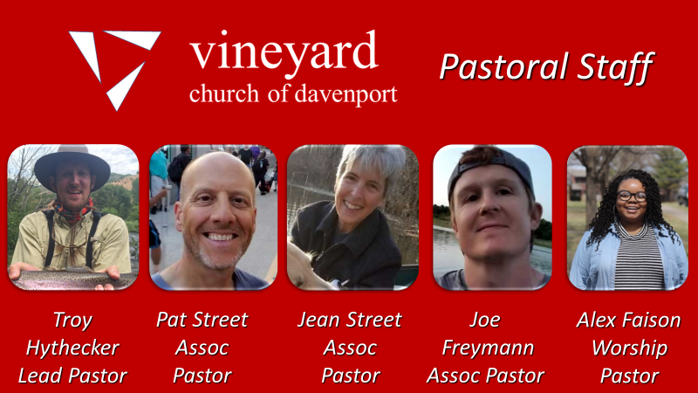

Slide 22
How’s Your Marriage?
Vineyard offers Marriage Coaching to all couples who are about to get married or are already married.
You are paired with a trained, peer coach couple who will help you learn how to communicate better and enjoy your marriage.
Write in on your Connect! card for more info!

Slide 23
Some people like it LOUD
Some people like it quiet
We have a quiet zone set up for anyone
who likes music at lower volumes.
Come to the front seats on the south side
of the auditorium.

Slide 24

Please recycle the outer shell of your bulletin to be a good steward of the environment and save money!
The recycling bin is on or under a small table in the Café between the auditorium doors.

